Slide 1
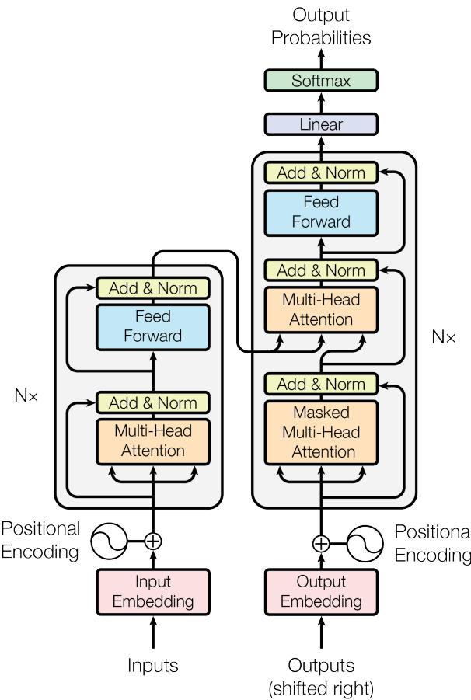
The core idea and why it changed sequence modeling
Introduce the Transformer: an attention-only architecture enabling full parallelism and fast training.
Learning target
Understand how attention-only Transformers replace recurrence/convolution and deliver faster, strong translation.
Agenda
Self-attention: tokens look at other tokens
Multi-Head Attention: many views in parallel
Architecture: encoder–decoder stacks, masking, positions
Training setup and translation quality
What heads learn
Why it mattered
Takeaway: Attention-only architectures can match or exceed state-of-the-art translation with far less training cost.
Check: Compared to RNN/CNN sequence models, what two components does the Transformer remove?

Slide 2
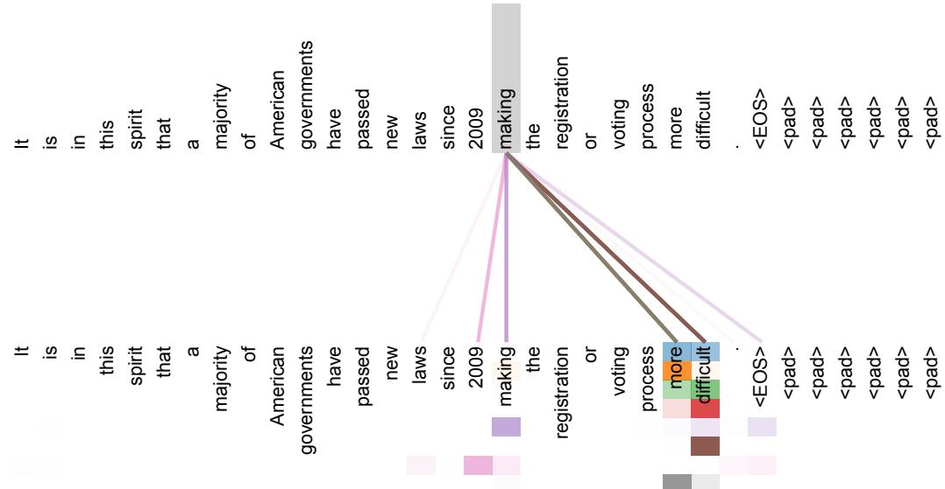
Self-Attention: how tokens decide what matters
Parallel context mixing without recurrence or convolution.
1) Build Q, K, V
Each token projects to queries (Q), keys (K), and values (V).
2) Score & normalize
Similarity scores QK^T / sqrt(d_k) → softmax weights across tokens.
3) Weighted mix
Each token becomes the weighted sum of V using those attention weights.
Scaled dot-product attention (Vaswani et al., 2017): scaling by 1/sqrt(d_k) stabilizes training at larger d_k.
Check: What produces the attention weights for each token in self-attention?

Slide 3
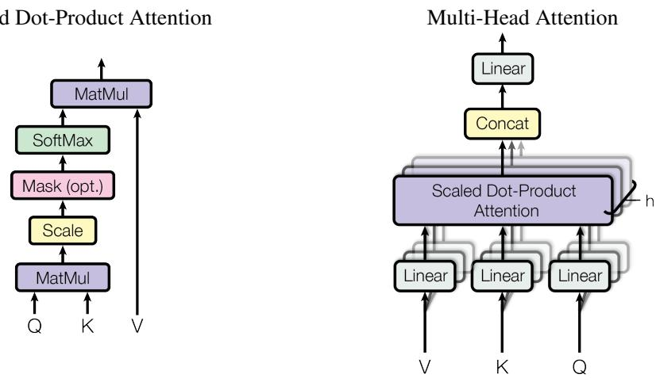
Multi-Head Attention — Worked Example
We walk one token through multi-head attention using the base setting (h = 8 heads, d_{k} = d_{v} = 64).
1
Project Q, K, V into heads
Split Q, K, V into h parallel subspaces via learned projections.
Base: h = 8 heads with d_{k} = d_{v} = 64.
Each head gets its own W^{Q}_{i}, W^{K}_{i}, W^{V}_{i}.
2
Attend per head (parallel)
For each head i, compute scaled dot‑product attention.
head_{i}(Q, K, V) = softmax(Q_{i}K_{i}^{T} / √64) V_{i}.
All token‑to‑token interactions computed in parallel.
3
Concatenate and mix
Concatenate the h head outputs and apply a final linear W^{O}.
Different heads capture different relations concurrently.
Output feeds the position‑wise feed‑forward network.
Takeaway: Multiple heads let the model look at different relations at once; concatenation preserves them for the next layer.
Check: Why use multiple attention heads instead of a single head?

Slide 4
Core Definitions — Transformer Basics
Ground the key terms before we go deeper: self‑attention, multi‑head, positional encoding, masking, and normalization.
Definition Callout
Key Idea
What the core terms mean
Attention + position replaces recurrence
Scaled dot‑product attention: Attention(Q, K, V) = softmax(QK^{T} / √d_{k}) · V
By stacking simple attention blocks with positional signals and masking, the Transformer builds an efficient, fully parallel sequence model—no recurrence or convolution needed.
Self‑attention: tokens attend to other tokens to decide what matters; all pairwise interactions computed in parallel.
Multi‑Head Attention: project Q/K/V into multiple subspaces, attend in parallel, then concatenate.
Positional encoding: fixed sinusoidal (learned performs similarly) added to embeddings to convey token order.
Residual + LayerNorm: residual connections and layer normalization wrap each sub‑layer; dropout used throughout.
Decoder self‑attention uses a mask so positions cannot attend to the future.
Check: What role does positional encoding play in the Transformer?

Slide 5
Transformer Mechanism — Encoder–Decoder Walkthrough
From tokens to outputs in five steps (process view).
1
2
3
4
5
Embed + Positions
Encoder Stack (×N)
Shifted Targets
Decoder Layer
Predict Token
Token embeddings are summed with sinusoidal positional encodings.
Decoder input is the shifted target sequence (training) plus positions.
Masked self‑attention → encoder‑decoder attention → feed‑forward.
Linear layer + softmax produce next‑token distribution.
Each layer: self‑attention → feed‑forward, with residuals and layer norm.
Greedy/beam search at inference; teacher forcing during training.
Gives the model information about order.
Masked self‑attention prevents peeking ahead.
Cross‑attention reads from encoder outputs.
Self‑attention lets tokens look at others in the source.
Takeaway: The encoder builds context with self‑attention; the decoder generates step‑by‑step, attending to both prior outputs and the encoded source.
Layer components
Multi‑Head Attention: parallel heads capture diverse relations; concatenated and projected.
Position‑wise FFN: applied identically at each position.
Residual connections + LayerNorm around each sublayer.
Check: Why must decoder self‑attention be masked during training and inference?

Slide 6
Boundaries & Scope — Transformer Attention
Clarify common confusions and surface limits noted or implied by the paper.
Common confusions
Limits & scope (per paper)
No recurrence ≠ no order. Order is injected via positional encodings (sinusoidal) added to embeddings.
What to keep in mind when sequences grow or contexts change.
Quadratic cost in length: Full self‑attention is O(n²) in n; long sequences increase memory/compute.
Local/restricted attention: The authors note attention can be limited to neighborhoods for tasks with local structure to reduce cost.
Task scope: Evidence is from machine translation (WMT EN–DE/EN–FR); other domains are outside this paper’s evaluation.
Training regimen matters: Stability/performance rely on large batches, learning‑rate warmup, and label smoothing as described.
"Heads = separate models"? No — heads are parallel projections whose outputs are concatenated and re‑projected.
"Attention always slower"? Self‑attention scales well on hardware via parallelism, though cost grows with sequence length.
"No convolution means weaker local patterns"? Multiple heads can still focus locally when useful.
Takeaway: Self‑attention enables parallel learning but has O(n²) time/memory with sequence length; positional encodings carry order, and careful training/setup are part of the recipe reported.
Check: In what scenario does the cost of full self‑attention become a bottleneck, and how might the paper suggest addressing it?

Slide 7
Scaled Dot-Product & Multi-Head Attention — Concept Build
1
Scores: Q · Kᵀ / √d_{k}
2
Weights via softmax
3
Context: weighted sum of V
4
Multi-head: parallel views
Measure how much each query Q aligns with keys K, scaled by √d_{k} to keep magnitudes stable.
Turn scores into attention weights that sum to 1 across positions.
Use the weights to gather relevant information from values.
Run several heads in parallel, then concatenate and project, enabling attention to different aspects.
Q
K
O = A · V
O = A · V
A = softmax(S)
A = softmax(S)
Concat(head_{1..h})W_{O}
Concat(head_{1..h})W_{O}
Core source anchors
S = QKᵀ / √d_{k}
S = QKᵀ / √d_{k}
Scaled dot-product Formula: softmax(QKᵀ/√d_{k})V — Vaswani et al. (2017), Section 3.2.
Scaled dot-product
softmax(QKᵀ/√d_{k})V
Multi-head rationale "Allows the model to jointly attend to information from different representation subspaces at different positions." — Vaswani et al. (2017), Section 3.2.
Multi-head rationale
Takeaway: Attention = scores → weights → context; multi-head = parallel views that enrich representations.
Check: Why divide by √d_{k} before softmax?

Slide 8
Recap — Attention Is All You Need
Summary ladder
1
Problem → Recurrent/convolutional models limit parallelism and struggle with long-range dependencies.
Motivation for a new sequence transduction approach.
Final synthesis
The Transformer replaces recurrence with attention, scaling training through parallelism while preserving context via multi-head, positionalized attention.
Motivation for a new sequence transduction approach.
2
Core Idea → Use self-attention to let each token focus on the tokens that matter.
Removes recurrence and convolution; enables full-sequence parallelism.
Removes recurrence and convolution; enables full-sequence parallelism.
Next steps (from the paper)
3
Architecture → Encoder–decoder with multi-head attention and positional encoding.
Heads attend to different subspaces; positions are injected to retain order.
Revisit the scaled dot-product attention formula and intuition.
Trace one encoder layer: MH-Attention → Add&Norm → FFN → Add&Norm.
Compare Base vs. Big settings and training setup details.
Heads attend to different subspaces; positions are injected to retain order.
4
Evidence → Strong machine translation results on WMT14 EN–DE and EN–FR.
Source-backed improvements with faster training due to parallelism.
Source-backed improvements with faster training due to parallelism.
5
Check your understanding
Impact → Simpler, faster training and better long-range reasoning.
Attention became the foundation for modern sequence models.
Attention became the foundation for modern sequence models.
Why does removing recurrence enable faster training, and how do positional encodings compensate for the loss of order?

